Slide 1
DevOps

Slide 2
Software Development
PLAN
CODE
BUILD
TEST

Slide 3
Operations
Deploy
Operate
Monitor

Slide 4
DevOps
Software Development
Operations

Slide 5
DevOps
Devops is a combination of development and operations.
The main aim of DevOps is to shorten the system's development life cycle.
DevOps is like a framework that makes use of lot of software based tools.

Slide 6
DevOps
These different tools perform different tasks of various stages of software development and or operations.
Most of these tools automate various tasks.
These tools also hide or reduce the complexity of performing these tasks.

Slide 7
DevOps
Thus DevOps allows a single team to manage the entire development life cycle of an application.
DevOps consist of various stages - Continuous Development, Continuous Integration, Continuous Testing, Continuous Deployment and Continuous Monitoring.

Slide 8
DevOps Lifecycle
Continuous Development
This phase involves planning of the software and then followed by the coding of the software.
There are no tools used for planning.

Slide 9
DevOps Lifecycle
However tools like phabricator can help in planning the activities related to development.
In the coding stage version control system tools like Git, SVN, Mecurial are used.
Tools like Maven, Ant are used to build and package the code into executable.

Slide 10
DevOps Lifecycle
Continuous Testing
This stage checks the software developed for any bugs.
Tools like selenium, TestNG , JUnit are used.
Automated testing saves a lot of time and efforts.

Slide 11
DevOps Lifecycle
Continuous Integration
As the software is continuosly developed, the new code should be immedietely integrated wth the existing code and tested.
This phase performs this task with the help of tools like jenkins.

Slide 12
DevOps Lifecycle
As the developer submits the code to the repository, Jenkis takes this code and builds into an executable package. It is then forwarded to the test server.
Once the code is successfully tested then Jenkins sends it to the production servers.

Slide 13
DevOps Lifecycle
Continuous Deployment
As the software comes to the production environment, the first thing required is the proper working environment and proper configuration.
Tools like puppet, Ansible, Chef are used to configure servers with required working environment.

Slide 14
DevOps Lifecycle
This phase makes sure that the updates and fixes are rolled out to all the servers.
Also makes sure that proper configuration is maintained across all servers.
Containerization platform like Docker are used in continuous testing and deployment also.

Slide 15
DevOps Lifecycle
Continuous Monitoring
In this phase the software performance is monitored in the production environment.
The fuctional usage, errors are monitored.
Root cause analysis for errors is performed.

Slide 16
DevOps Lifecycle
Tools like Splunk and Nagios are used.
The inputs from this phase are passed to the software development team.
Based on these inputs the new features or fixes for the bugs are planned and accordingly coding is done.
This is how the next cycle of DevOps begins.

Slide 17
Microservices

Slide 18
Microservices
Microservices is an architecture that helps build an application as a collection of loosely coupled and independently manageable services.
It is best suitable for applications which can be broken down into smaller, composable pieces which can work together.

Slide 19
Monolithic Vs Microservice
In monolithic architecture all the components of an application are developed together and tightly coupled.
Following are the drawbacks of the monolithic architecture.
1. They are inflexible as you can not use different technologies.
2. They are not fault tolerant as if one component fails, the entire application fails.

Slide 20
Monolithic Vs Microservice
Following are the drawbacks of the monolithic architecture......continued
3. They are not scalable as a specific component of the application can not be upgraded, entire application needs to be upgraded.
4. These types of application development process is slow, As sequential development approach is required.
5.They do not allow continuous development, as individual features can not be separately build and tested.
These problems led to the concept of microservices.

Slide 21
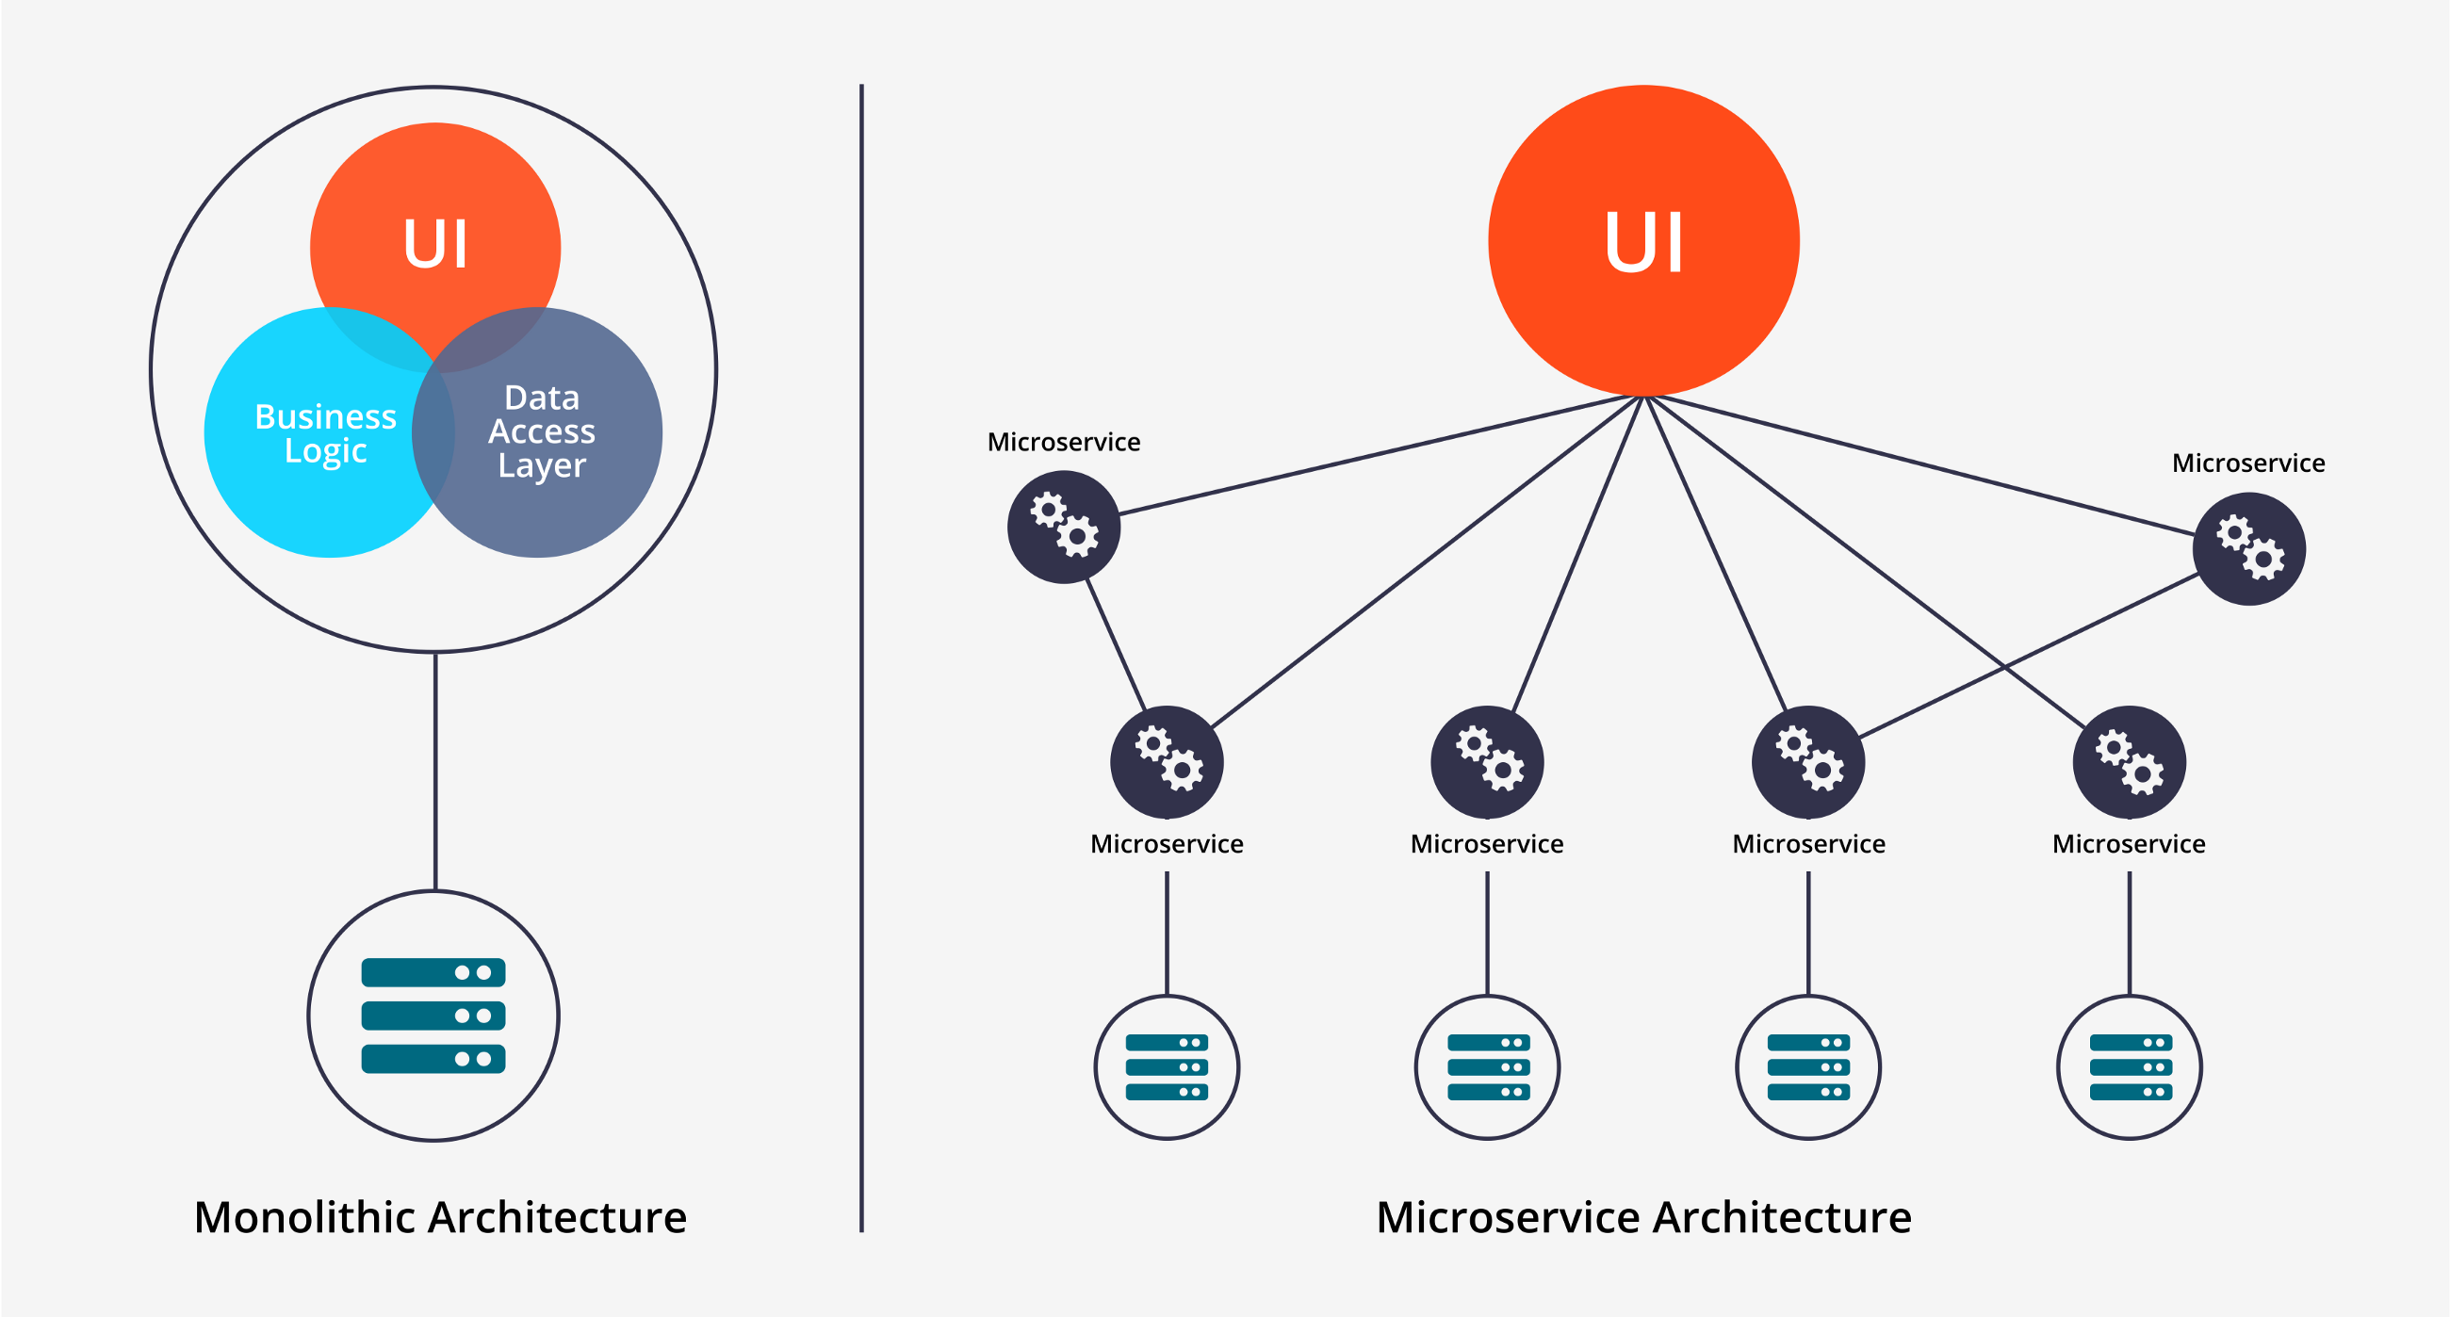
Monolithic Vs Microservice

Slide 22
Microservices
Microservices as they are a set of modular components are easier to understand, easier to develop, easier to test and easier to maintain over the entire lifetime.
They provide a much higher agility and thus reduce the time required to develop the application.

Slide 23
Microservices
The microservices provide following benefits.
1. Small teams can work in parallel and develop services faster.
2. If one of the components fails, you can start another instance of that component while other components continue to work.
3. Resource allocation becomes easier. Only required components can be scaled to meet the increasing load demands.

Slide 24
Microservices
Each microservice has its own load balancer and execution environment and mostly has its own database.
These microservices identify the other services using service discovery.
These microservices communicate with each other using a stateless server using REST or Message bus

Slide 25
Microservice Architecture

Slide 26
Microservice Architecture
The management component is responsible for deploying services on nodes, scaling services as per load requirements, detecting failures, rebalancing services across other nodes.
The service discovery component maintains a list of services and the nodes that are hosting these services. They provide endpoints to connect to these services.

Slide 27
Microservice Architecture
The API gateway provides the connection point for the clients.
The API gateway forwards the call to the appropriate service on the back end.
The API gateway may combine the response from different services and return an aggregate response to the client.

Slide 28
Microservice Architecture
The API gateway decouples the client from the services.
This helps easy management of services in the background without having to update the clients.
API gateways can often provide other functions like authentication, load balancing and logging.

Slide 29
Microservices deployment patterns
1. Single Service Instances per Host
Traditional Approach
Each service instance executes on its own server/host.
Provides isolation between each service instances.
No conflicting resource requirements or version dependency.
Less efficient and costly.

Slide 30
Microservices deployment patterns
2. Multiple Service Instances per Host
Multiple service instance executes on single server/host.
efficient resource utilization and less costly.
Need techniques to provide isolation between each service instances. (Not possible also)
conflicting resource requirements or version dependency may occur.

Slide 31
Microservices deployment patterns
3. Service Instances per VM
Each service is packaged as a virtual machine image and executed on an independent VM.
efficient resource utilization and less costly.
Provides isolation between each service instances.
No conflicting resource requirements or version dependency.
Easy Scaling (Add more VM's)
Deploying VM is slow and managing VM's is a time consuming.

Slide 32
Microservices deployment patterns
4. Service Instances per Container
Each service instance executes on single container.
Each service is packaged as a container image and executed on an independent container.
efficient resource utilization and less costly than VM approach.
Provides isolation between each service instances.
No conflicting resource requirements or version dependency.
Easy and fast scaling (Faster than Deploying VM)
New Technology as compared to Hypervisor.

Slide 33
API Gateway
Direct Client to Microservice communication

Slide 34
API Gateway
Direct Client to Microservice communication
In this method each microservice gets an public endpoint(URL).
Each microservice may get a different port number.
A production environment may use a load balancer and or Application Delivery Controller.

Slide 35
API Gateway
Direct Client to Microservice communication
This approach is suitable for small micro service based application.
Client app requires services from multiple backend microservices, thus client needs to call different endpoints frequently.
This increases the round trip between client and server. (Increases Latency)

Slide 36
API Gateway
Direct Client to Microservice communication
Need to update client for each new microservice introduced. (Clients tightly coupled)
Microservices need to be exposed directly to the internet. (More prone to attacks)
Microservices should perform authentication, SSL and logging. (Increased overheads)

Slide 37
API Gateway

Slide 38
API Gateway
The API gateway is the solution to the earlier problems in the client to microservices direct communication.
The API gateway may handle multiple different client applications.
To avoid bottleneck due to gateway, it is recommended to split the gateway into multiple service level gateways.

Slide 39
API Gateway

Slide 40
API Gateway
If the application has multiple client side applications, that can be a deciding factor in implementing a gateway.
Thus each gateway suffice the needs of each client application.
This Gateway implementation is known as 'Backend for Frontend(BFF)'.

Slide 41
API Gateway
The API Gateway may provide following features.
Reverse proxy - the gateway provides a single end point or URL to the client apps and then internally maps the calls to internal microservices.
This helps manage the microservices independently of client apps. (Adding/removing/shifting of microservices)

Slide 42
API Gateway
The API gateway may aggregate response for multiple requests from a client application. (reduce latency).
The API gateway can perform the tasks like authentication, Load balancing and Logging etc.

Slide 43
Gateway Patterns
Gateway Routing Pattern

Slide 44
Gateway Patterns
Backend for Frontend Pattern

Slide 45
Gateway Patterns
Gateway Aggregation Pattern

Slide 46
Gateway Patterns
Gateway Offloading Pattern

Slide 47
API Gateway Products
KONG
AZURE API management (Microsoft)
Snap Logic
WSO2
3Scale (Red Hat)
Mashery
Oracle API Manager
Google Cloud Endpoints
WebMethods

Slide 48
Service Discovery
A code may invoke a service that has a REST API.
In order to make a request for the service the code needs to know the network location of one of the instance of that service.
In traditional environment the location is mostly fixed as the service is bind to a fixed server.

Slide 49
Service Discovery
However in flexible environments like cloud, it is difficult to find the network location of a service as the service instance keep on changing.
These changes are due to failovers, auto-scaling, upgrades etc.
Thus there is a need for a proper service discovery mechanism.

Slide 50
Service Discovery
Client side Service Discovery
Client is responsible for identifying the network location of the required service instances and load balance requests across them.
A service registry which is a database of available service instances is created.
The client queries this registry to find the required service.

Slide 51
Service Discovery
The client then uses load balancing technique and sends the request to one of the available service instance.
Each service instance is required to register its network location (IP address and port) with the service registry.
The service instance entry is removed when the instance terminates.

Slide 52
Service Discovery
The client application is coupled with service registry.
The developer needs to build the service discovery logic in all client side applications.
Also client application should be intelligent enough to take application specific load balancing decisions.

Slide 53
Service Discovery
Server side Service Discovery
In this mechanism client makes a service request to a frontend which is mostly a load balancer.
The load balancer then queries the service registry and finds the list of service instances.
It then routes the request to the selected instance

Slide 54
Service Discovery
The main advantage of this technique is that the service discovery process is completely transparent to the client.
The developer is not required to build any service discovery logic or intelligence in client application.
The load balancer is a must component in this technique at the server end.

Slide 55
Thank you!

